Slide 1
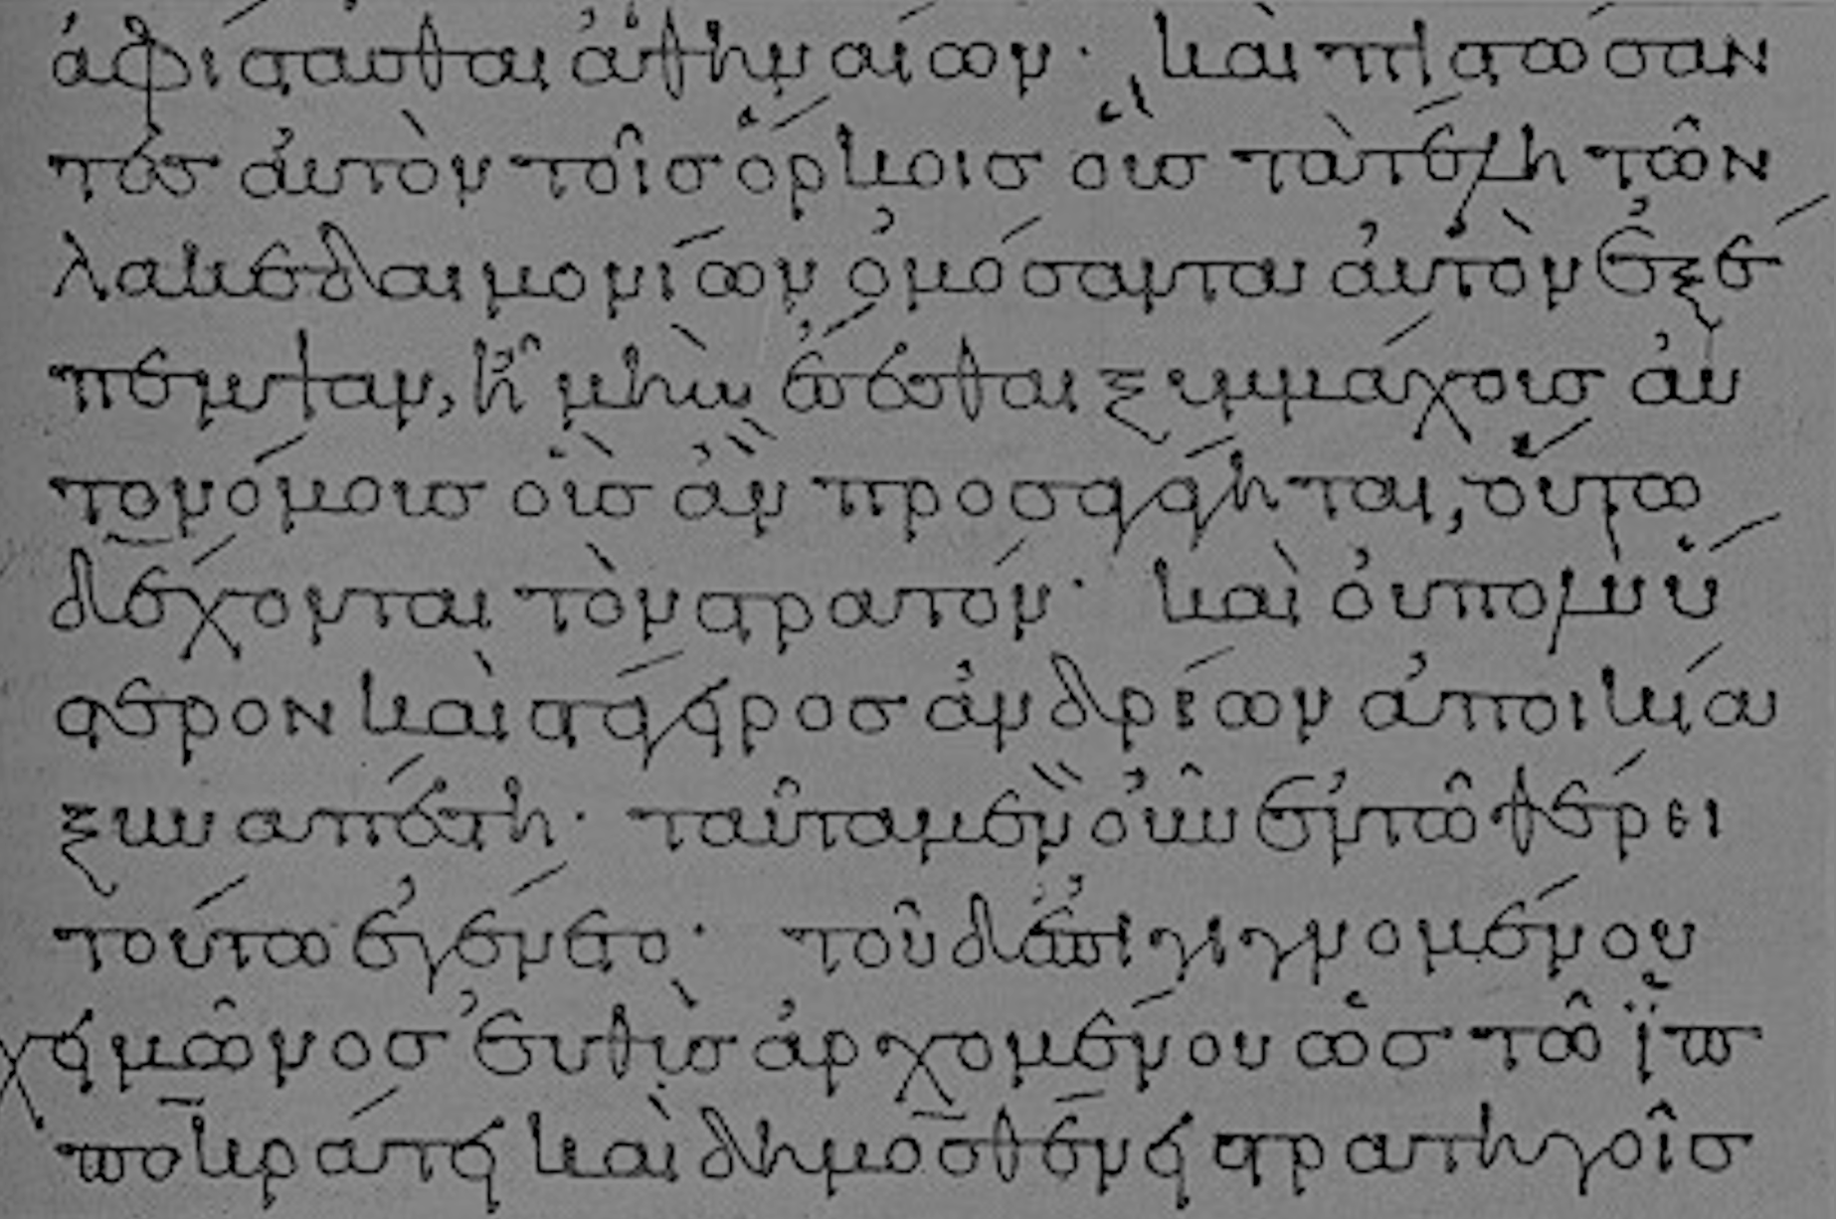
New Testament Critical Studies
The NT Canon
Dr. Rick Griffith • Jordan Evangelical Theological Seminary • BibleStudyDownloads.org

Slide 2
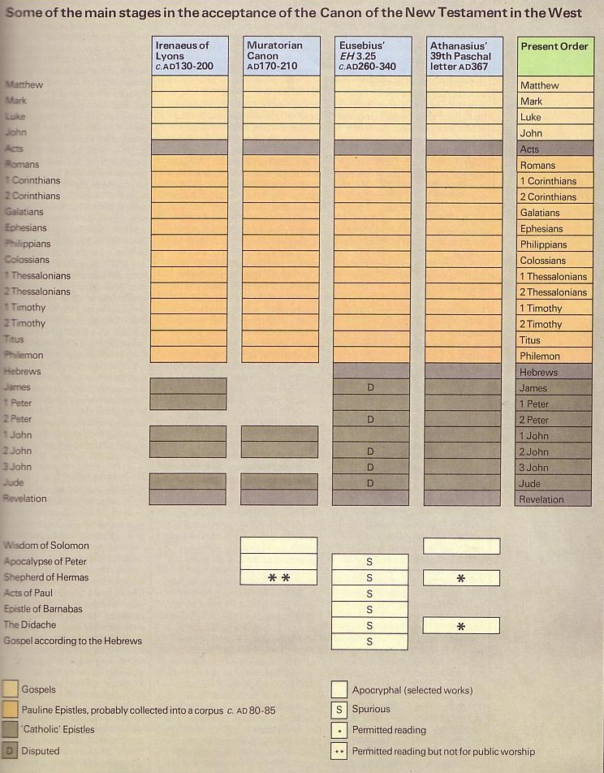
NT Canonicity
156-157
Apostolic
Accepted

Slide 3
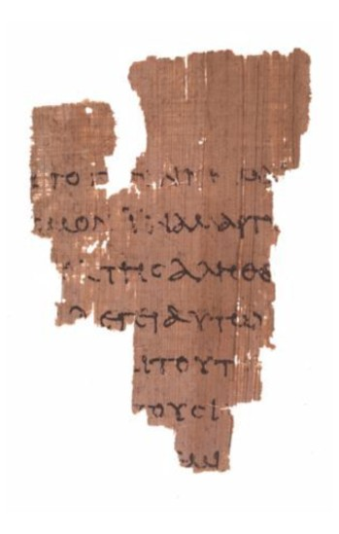
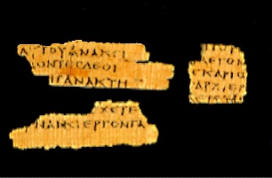
Really Early Fragments!
156-157
Magdalen Fragment of Matthew
AD 50-200
John Rylands Fragment of John 18:31-33, 37-38
AD 125
Notes:
http://www.tyndalehouse.com/staff/Head/P64TB.htm says the Magdalene fragment is actually from about AD 200.

Slide 4
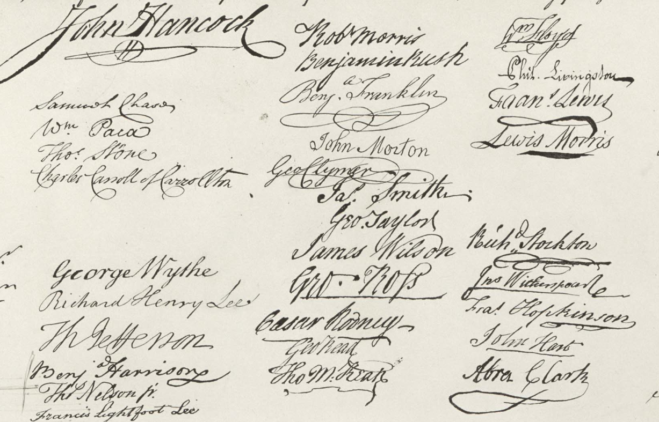
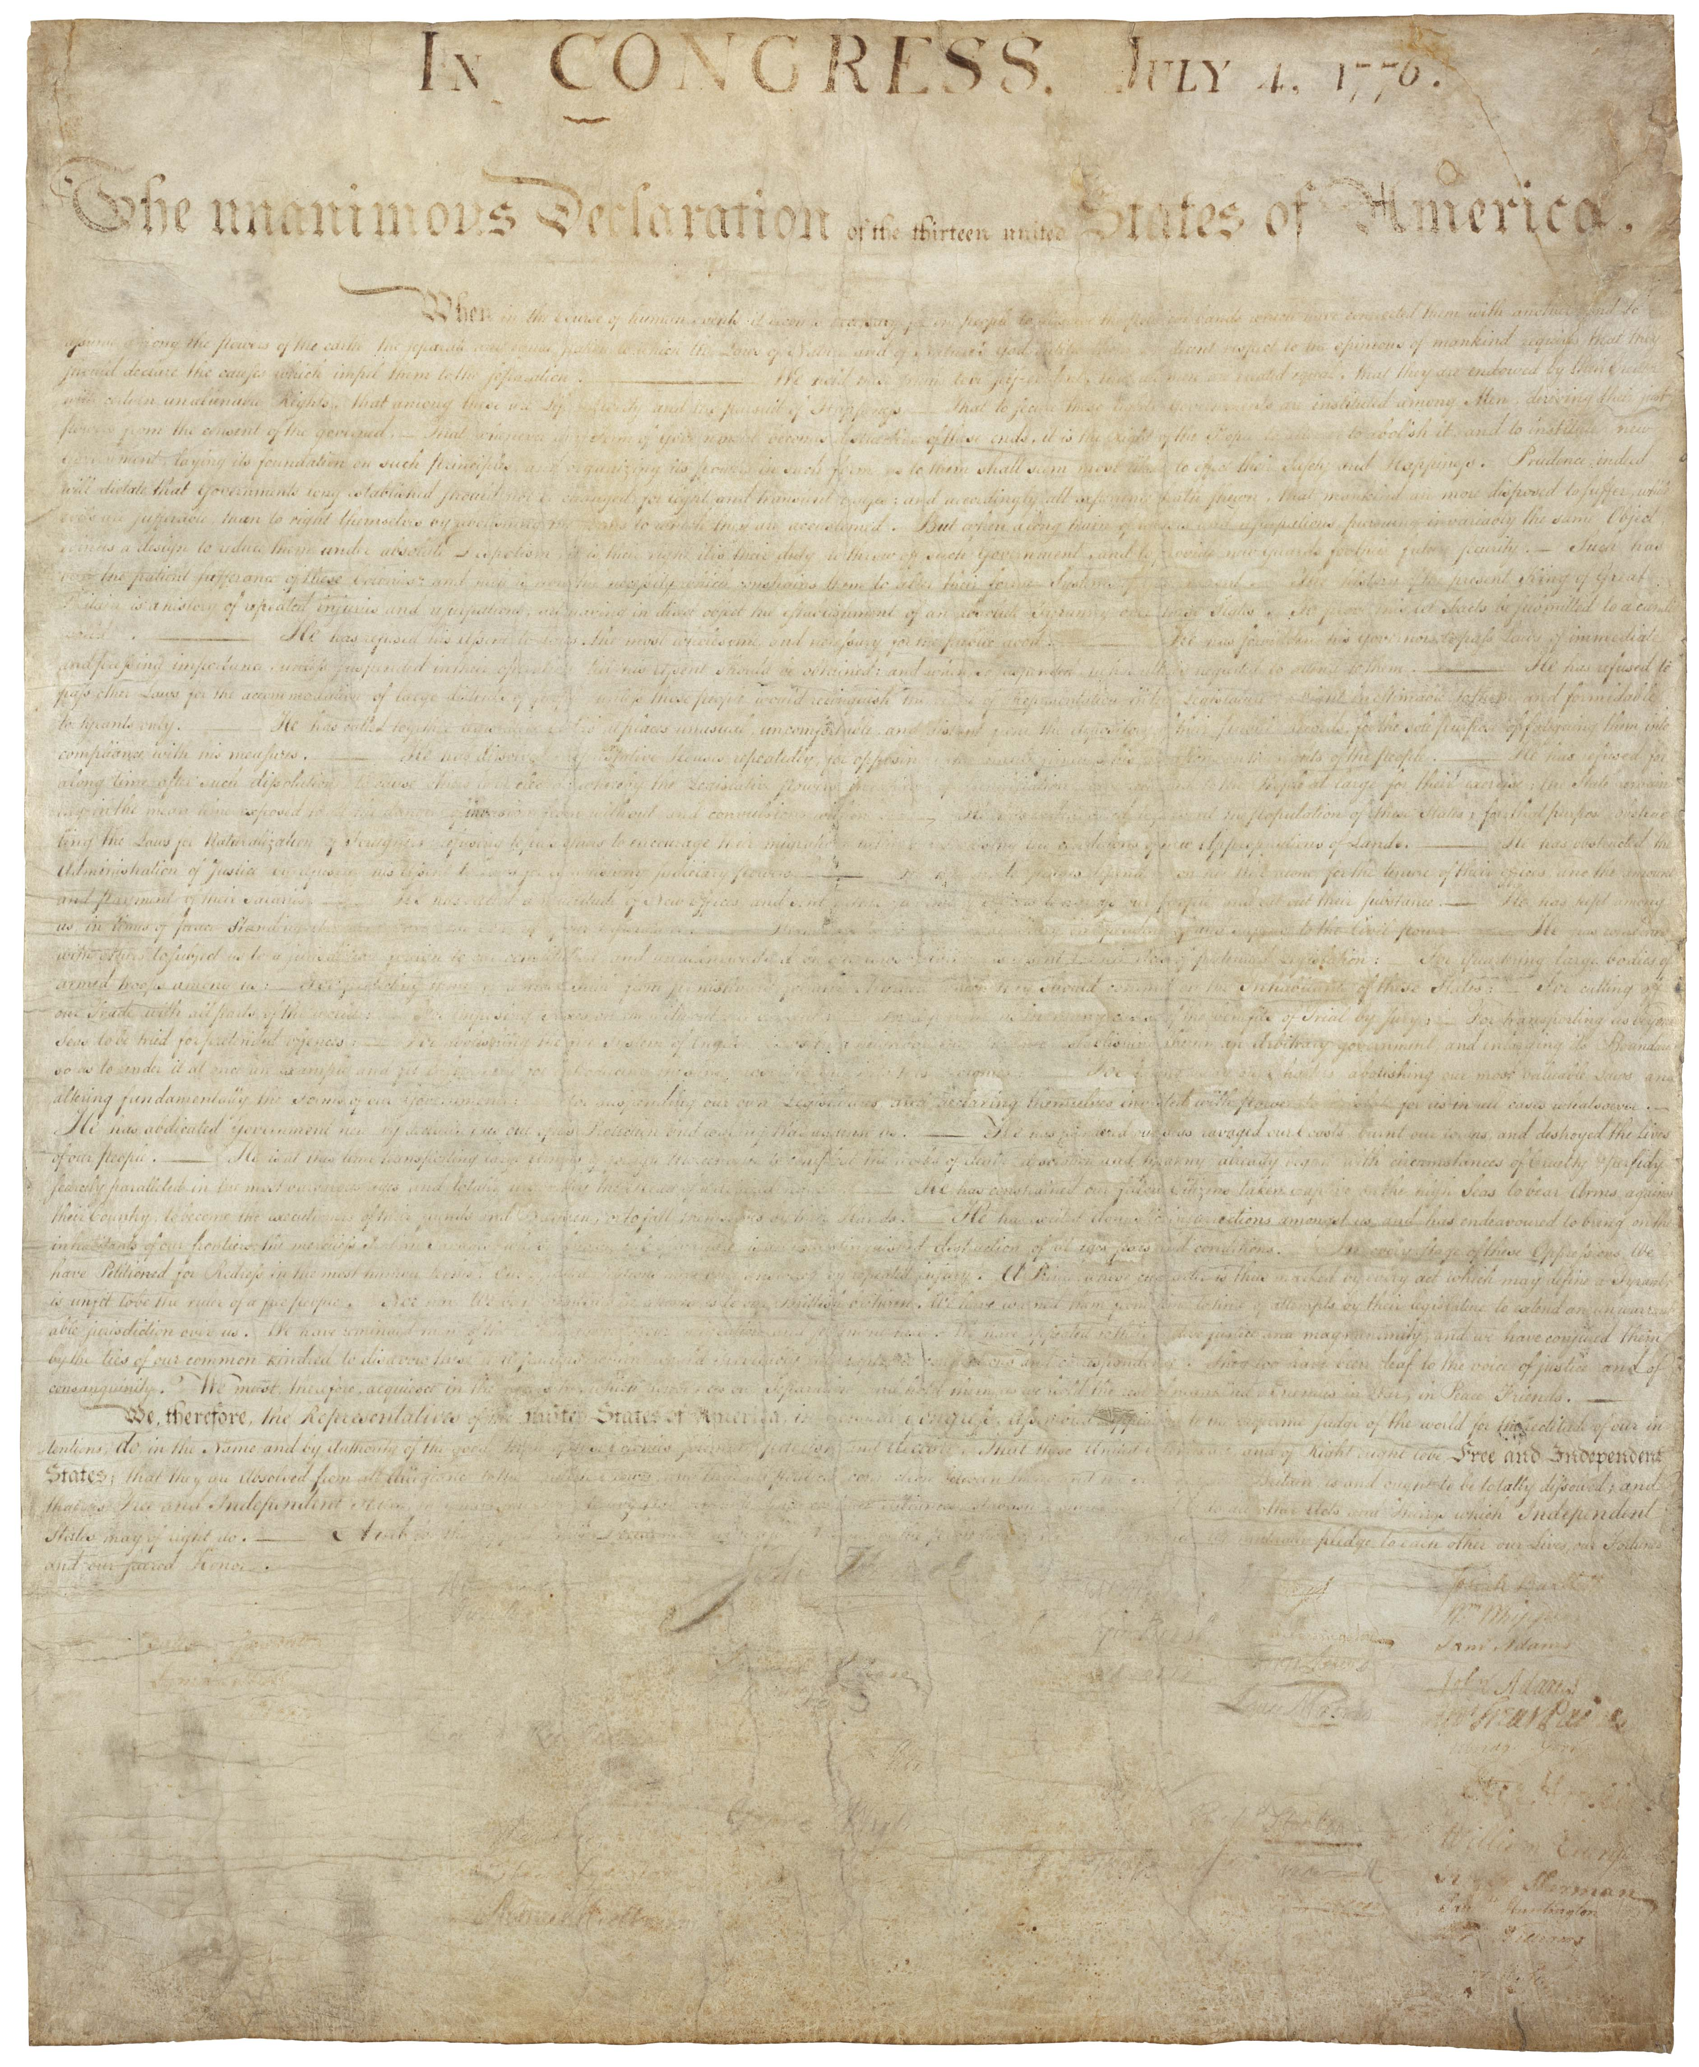
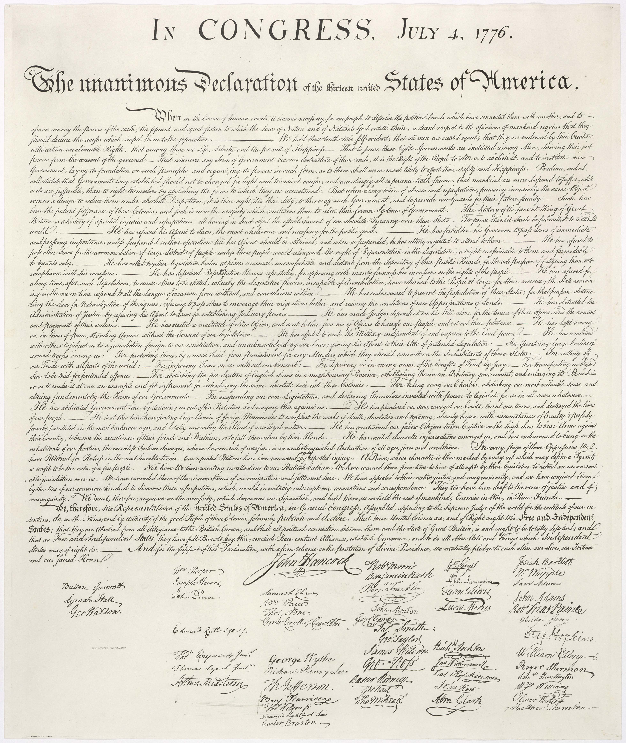
Why No Original NT Documents?
Original Declaration of Independence
AD 1776
Engraving of the Declaration by printer William J. Stone
AD 1823
Notes:
The original Declaration of 1776 is only just over 200 years old but is barely readable.
• Fortunately, a printer in 1823 engraved it, which has become the most frequently reproduced version of the document.
On it you can clearly see the signatures.
However, no such preservation techniques were possible for the original OT and NT documents, so only copies preserved in arid weather survived.
It is believed by some that, after the OT and NT autographs were copied accurately and proofread, these originals were then destroyed to prevent anyone from tampering with them.
http://www.archives.gov/exhibits/charters/declaration.html

Slide 5
NT Canonicity
156-157
Apostolic
Accepted

Slide 6

Paul Called Luke's Gospel "Scripture" within 5 years!
For the Scripture says, "Do not muzzle the ox while it is treading out the grain," and "The worker deserves his wages" (1 Timothy 5:18).
Macedonia
Paul Wrote 1 Timothy
AD 62
Caesarea
Luke Written
AD 57-59
Stay in that house, eating and drinking whatever
they give you, for
the worker deserves his wages… (Luke 10:7)

Slide 7
Peter Also Called Paul's Letters "Scripture"!
Paul's Letters Written
AD 49-62
Rome
Peter Wrote 2 Peter
AD 64
"…Our dear brother Paul also wrote to you with the wisdom God gave him. He writes the same way in all his letters, speaking in them of these matters. His letters contain some things that are hard to understand, which ignorant and unstable people distort, as they do the other Scriptures, to their own destruction" (2 Peter 3:15-16)

Slide 8
NT Canonicity
156-157
Apostolic
Accepted
Doctrine

Slide 9
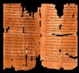
Clearing History
36
The New Testament Canon During the First Four Centuries
H. Wayne House
Acceptance of the Four Gospels Before Nicaea
Individuals
Canons
Translations
Origen (185-254)
Didache (120-150)
Papias (130-140)
Pseudo-Barnabas (70-130)
Clement of Rome (95-97)
Polycarp (110-150)
Justin Martyr (150-155)
Irenaeus (130-202)
Hermas (115-140)
Marcion (140)
Cyril of Jerusalem (315-386)
Tatian Diatesseron (170)
Old Latin (150-170)
Muratonian (170)
Barococcio (206)
Old Syriac (200)
X= Citation
or allusion
Apostolic (300)
O= Named
as authentic
Matthew
Mark
Luke
John
O
O
O
X
X
X
X
X
O
X
X
O
O
O
O
X
X
X
O
X
X
O
O
O
O
O
O
O
X
X
X
O
X
X
O
O
O
O
O
O
O
O
X
X
X
O
O
X
O
O
O
O
O
O
O
Gospel of Thomas
AD 50-140
Gospel of Judas
AD 170?
1st Cent.
AD 325
Council of Nicaea
Geisler & Nix, Introduction to the Bible (Chicago: Moody, 1968)
Notes:
This is found in H. Wayne House, Chronological & Background Charts to the New Testament, It is also the last page of the notes for this seminar. The point here is that our four gospels were consistently cited whereas "Brown's Gnostic gospels" were likely not even written until the second century (even if Thomas appeared as early as AD 40 it was still deemed heretical).

Slide 10

Extant Copies of Pagan vs. NT Writings
160
# | Author | When Written | Earliest Copy | Time Span | Number of Copies
6 | Plato | 347 BC | AD 900 | 1200 yrs | 7
12 | Catullus | 54 BC | AD 1550 | 1600 yrs | 3
14 | Pliny | AD 113 | AD 850 | 750 yrs | 7
NT | Paul, Luke, etc. | AD 95 | AD 200 | 100 yrs | 24,772
Josh McDowell, Evidence That Demands a Verdict, 40;
John Grassmick, “NT Introduction,” Dallas Seminary class notes, 160

Slide 11
Black

Slide 12


NT Backgrounds • BibleStudyDownloads.org
Get this presentation for free!
Notes:
NT Survey (ns)

